Slide 1
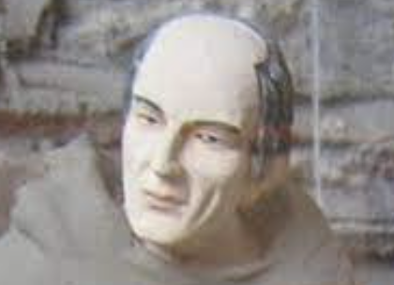
Monastic Tonsures

